Slide 1
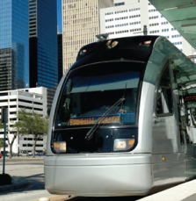

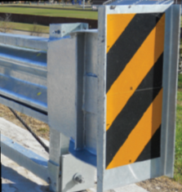
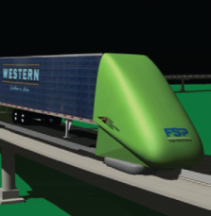

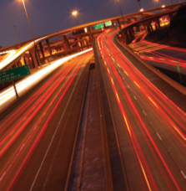
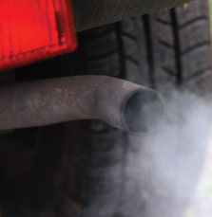
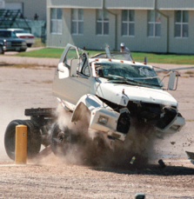


Updating TxDOT Workcodes
Srinivas Reddy Geedipally, PhD, PE
Associate Research Engineer, TTI
Notes:
Saving Lives, Time, and Resources

Slide 2
What are Workcodes (WC)?
……It’s Texas version of CMFs
102 | Install STOP Signs
 | Definition: | Provide STOP signs where none existed previously.
 | Reduction Factor (%): | 20
 | Service Life (Years): | 6
 | Maintenance Cost: | N/A
 | Preventable Crash: | Intersection Related = 1 or 2
=1 - CMF
=Target crashes

Slide 3
WC categories
Code | Item
100 | Signing and Signals
200 | Roadside Obstacles and Barriers
300 | Resurfacing and Roadway Lighting
400 | Pavement Markings
500 | Roadway Work

Slide 4
Methodology for Updating WC
Comprehensive review of literature
  Collect CMFs for a specific treatment
    CMF Clearinghouse
    Journal papers and project reports
Quality check and pre-selection on the Selection of CMFs
  Soundness of data analysis and methodology
  Higher star quality in the CMF Clearinghouse
  Relevance of specific target crash type, severity, and roadway environment
Estimate a single value from multiple CMFs
  Meta-analysis
Compare results with the value in the TxDOT WC Table
  Keep or update the WC Table CMF

Slide 5


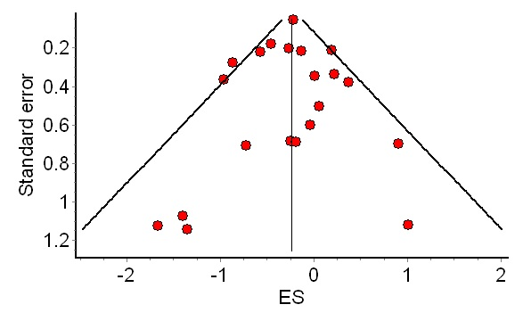
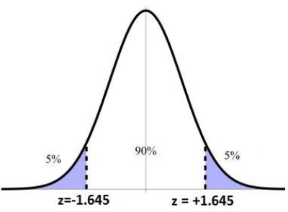
Review Lit. and Collect CMFs
Quality Check and Pre-selection
Meta-Analysis
WC within CI
Keep WC CMF
WC out of CI
Update WC CMF
Compare with WC
A Single CMF with CI
* All images from internet

Slide 6
Example
Treatment: Converting minor-road STOP to all-way STOP control
TxDOT WC: No. 121, CMF = 0.85 (i.e., CRF = 15%)
121 | Convert 2-way STOP Signs to 4-way STOP Signs
 | Definition: | Provide 4-way STOP signs where 2-way STOP signs existed previously
 | Reduction Factor (%): | 15
 | Service Life (Years): | 6
 | Maintenance Cost: | N/A
 | Preventable Crash: | Intersection/Intersection Related = 1 or 2
https://ftp.txdot.gov/pub/txdot-info/trf/trafficsafety/engineering/work-codes.pdf

Slide 7
Example
Literature Review and Pre-Selection:
Study | CMF | SE | Crash Type | Crash Severity | Roadway Type
Lovell and Hauer (1986) | 0.25 | 0.03 | Angle | All | - Stop-controlled intersections
Harwood et al. (2000) | 0.52 | 0.04 | All | All | - Stop-controlled intersections
Simpson and Hummer (2010) | 0.319 | 0.022 | All | All | - 4-leg intersections - 53 Stop-controlled intersections in NC - 680 to 15,400 AADT
Notes:
Lovell and Hauer (1986) conducted a before-after analysis related to converting minor-road STOP to all-way STOP control, and found that the type of an angle crash decreased by 75 percent after its conversion. In the studies by Harwood et al. (2000) and Simpson and Hummer (2010), this countermeasure enables all type crashes to decrease by 48 percent and 68 percent. The cost of conversion from two-way to all-way stop control with dual oversized stop signs is approximately $5,000 (Simpson and Hummer 2010).
that the CMF of Lovell and Hauer (1986) is excluded due to different target crash type.

Slide 8


Example
Meta-Analysis:
$${CMF}_{comb}=\frac{\sum_{i=1}^{n}{{{CMF}_{i}}/{{SE}_{i}^{2}}}}{\sum_{i=1}^{n}{1/{{SE}_{i}^{2}}}}=\frac{{0.52}/{{0.04}^{2}}+{0.319}/{{0.022}^{2}}}{1/{{0.04}^{2}}+1/{{0.022}^{2}}}=0.37$$
$$SE({CMF}_{comb})=\sqrt{\frac{1}{\sum_{i=1}^{n}{1/{{SE}_{i}^{2}}}}}=\sqrt{\frac{1}{1/{{0.04}^{2}}+1/{{0.022}^{2}}}}=0.02$$
Combined CMF | Combined SE | 90% Confidence Interval of CMF
 |  | Low | High
0.37 | 0.02 | 0.34 | 0.40

Slide 9
Example
Compare with WC CMF:
WC CMF 0.85 does NOT fall in the CI 0.34 - 0.40
Recommend updating the WC CRF as 63% ( i.e., 1 – 0.37)
Convert 2-way STOP Signs to 4-way STOP Signs
Definition: | Provide 4-way STOP signs where 2-way STOP signs existed previously
Reduction Factor (%): | 15 -> 63
Service Life (Years): | 6
Maintenance Cost: | N/A
Preventable Crash: | Intersection/Intersection Related = 1 or 2

Slide 10
List of Updated WC - Intersection
No. | Name of Countermeasure | Work Code CMF | Single CMF | 90% CI | Recommended CMF
1 | Convert Minor-Road STOP to All-Way STOP Control | 0.85 | 0.37 | 0.34-0.4 | 0.37
2 | Install "STOP AHEAD" Pavement Markings | NA | 0.4 | 0.33-0.47 | 0.4
3 | Install Pedestrian Countdown Timer | NA | 0.65 | 0.39-0.91 | 0.65
4 | Install Stop Sign at Highway-Rail Crossing | NA | 0.68 | 0.65-0.71 | 0.68
5 | Implement Intersection Conflict Warning Systems on minor approach | 0.85 | 0.73 | 0.66-0.80 | 0.73
6 | Improve Sight Distance within Sight Triangle | NA | 0.68 | 0.53-0.82 | 0.68
7 | Install Transverse Rumble Strips at stop-controlled | 0.85 | 0.77 | 0.65-0.89 | 0.85 (No Change)
8 | Increase retroreflectivity of STOP signs | NA | 0.82 | 0.75-0.89 | 0.82
9 | Install Flashing Beacons at Intersection Approaches | 0.65 | 0.86 | 0.78-0.94 | 0.86
10 | Install Intersection Lighting at Rural Intersection | 0.55 | 0.87 | 0.79-0.95 | 0.87
11 | Implement systemic signing and marking improvement at stop-controlled intersections | NA | 0.92 | 0.84-0.94 | 0.92
12 | Change from Permissive with Circular Green Symbol to Flashing Yellow Arrow Signals and Supplemental Traffic Signs | 0.85 | 0.59 | 0.47-0.71 | 0.59
13 | Install Left-Turn Lane | 0.75 | 0.77 | 0.67-0.87 | 0.75 (No Change)
14 | Install Actuated Advance Warning Dilemma Zone Protection System | NA | 0.89 | 0.71-1.07 | 0.89
15 | Convert Stop-controlled Intersection into Roundabout | 0.6 | 0.38 | 0.28-0.48 | 0.38

Slide 11
List of Updated WC – Roadway Departure (partial)
No. | Name of Countermeasure | Work Code CMF | Single CMF | 90% CI | Recommended CMF
1 | Centerline Rumble Stripes/Strips | 0.65 | 0.74 | 0.73 - 0.76 | 0.74
2 | Edgeline Rumble Stripes/Strips | 0.50 | 0.85 | 0.83 - 0.88 | 0.85
3 | Raised Pavement Markers at Centerline | 0.65 | 0.83 | 0.78 - 0.88 | 0.83
4 | Raised Pavement Markers at Edgeline | 0.40 | 0.83 | 0.78 - 0.88 | 0.83
5 | Profile Centerline Markings | 0.65 | 0.93 | 0.89 - 0.97 | 0.93
6 | Profile Edgeline Markings | 0.40 | 0.93 | 0.89 - 0.97 | 0.93
7 | Static Curve Warning Sign (Standard) | 0.95 | 0.80 | 0.33 - 1.27 | 0.95 (No Change)
8 | Enhanced Curve Warning System – no comment | 0.65 | 0.62 | 0.57 - 0.67 | 0.65 (No Change)
9 | Wide Centerline Pavement Markings, 6” | NA | NA | NA | NA
10 | Wide Edgeline Pavement Markings, 6” | NA | 0.78 | 0.65 - 0.91 | 0.78
11 | Install Delineators | 0.70 | 0.88 | 0.79 - 0.97 | 0.88
12 | Install Surface Mounted Delineators on Centerline | 0.65 | 0.88 | 0.79 - 0.97 | 0.88
13 | High Friction Surface Treatment, Horizontal curves | 0.55 | 0.48 | 0.34 - 0.62 | 0.55 (No Change)
14 | Roadway Lighting | 0.60 | 0.54 | 0.51 - 0.57 | 0.54
15 | Remove or Shield Tree or Fixed Objects | 0.50 | 0.07 | 0.06 - 0.09 | 0.07

Slide 12
List of Updated WC – Pedestrian (partial)
No. | Name of Countermeasure | Work Code CMF | Single CMF | 90% CI | Recommended CMF
1 | Install Pedestrian Signal | 0.66 | 0.87 | 0.81-0.93 | 0.87
2 | Improve Pedestrian Signal | 0.90
3 | Install Pedestrian Countdown Timer | NA | 0.65 | 0.39-0.91 | 0.65
4 | Install Raised Pedestrian Crosswalks | NA | 0.54 | 0.39 - 0.70 | 0.54
5 | Implement Barnes Dance (Diagonal Crossing) | NA | 0.58 | 0.30 - 0.86 | 0.58
6 | Install Pedestrian Hybrid Beacon | 0.85 | 0.58 | 0.30-0.86 | 0.85 (No Change)
7 | "Install Pedestrian Hybrid Beacon (PHB or HAWK) with Advanced Yield or Stop Markings and Signs" | NA | 0.43 | 0.21 - 0.65 | 0.43
8 | Install Pedestrian Crosswalk | 0.90 | 0.55 | 0.00-2.09 | 0.90 (No Change)
9 | Install High-Visibility Crosswalk | NA | 0.78 | 0.26 - 1.30 | 0.78
10 | Median Crossing Island, Refuge Island, Raised Median | NA | 0.67 | NA | 0.67
11 | Automated Pedestrian Detection | NA | 0.91 | NA | 0.91
12 | Road Diet | NA | 0.59 | NA | 0.59
13 | Install Transverse Rumble Strips at Pedestrian Crosswalks | NA | 0.76 | 0.22 - 1.30 | 0.76
14 | Speed Humps | NA | 0.60 | 0.34 - 0.86 | 0.60
15 | Parallelogram-Shaped Pavement Markings | NA | 0.79 | 0.70 - 0.88 | 0.79

Slide 13
Framework for Combination of WC

Slide 14
The Context
There are multiple potential CMFs to use in the HSIP process
The applicable crashes for each WC vary in general

Slide 15





The Challenge
$${CMF}_{A}=1−\frac{20}{100}=0.80$$
Independence is assumed when CMFs for a crash type in common
When the CMFs are independent, they can be multiplied to find the combined effect
Consider the diagram of independent WCs:
  100 total crashes
  20 preventable by WC A
  5 preventable by WC B
  1 preventable by WC A or B
$${CMF}_{B}=1−\frac{5}{100}=0.95$$
$${CMF}_{A⋀B}=1−\frac{19+1+4}{100}=0.76$$
$${CMF}_{A}×{CMF}_{B}=0.80×0.95=0.76$$
A and B are independent because:
$${CMF}_{A⋀B}={CMF}_{A}×{CMF}_{B}$$

Slide 16
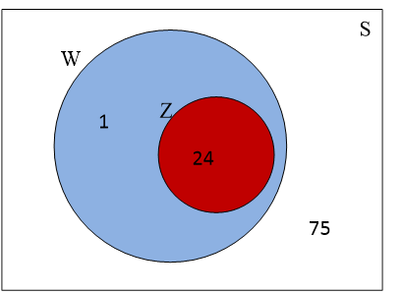
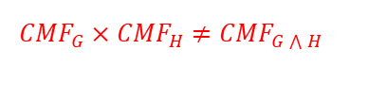
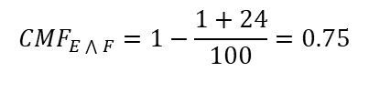
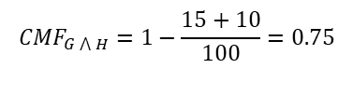


Non Independent CMFs on a common set of applicable crashes
$${CMF}_{E\bigwedge{F}}=1−\frac{1+24}{100}=0.75$$
$${CMF}_{G\bigwedge{H}}=1−\frac{15+10}{100}=0.75$$
$${CMF}_{E}×{CMF}_{F}=0.75×0.76=0.57$$
$${CMF}_{G}×{CMF}_{H}=0.85×0.90=0.765$$
$${CMF}_{E}×{CMF}_{F}≠{CMF}_{E\bigwedge{F}}$$
$${CMF}_{G}×{CMF}_{H}≠{CMF}_{G\bigwedge{H}}$$

Slide 17
New method of combining CMFs
CMF impacts are estimated for each of regions I and II
The proposed scheme is applied to region III
The overall combined CMF is the weighted average of the three regions

Slide 18
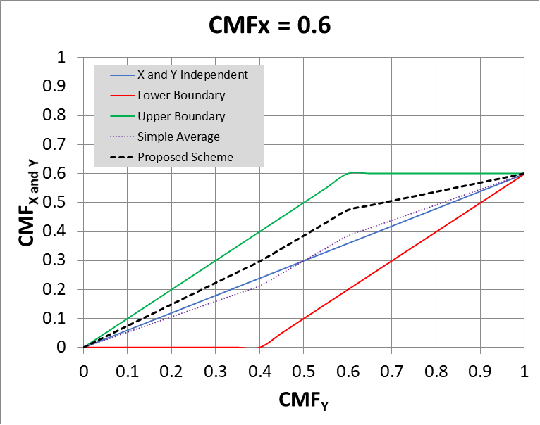
Combined CMF Determination
Identify the range of possible scenarios
  Between non-independence extremes
  Independence is on the major diagonal
Calculate weighed average of extremes and independent cases
Estimate is always more conservative than independence

Slide 19
Example
532 | Texturize Shoulders (rolled-in or milled-in)
 | Definition: | Install milled-in or rolled-in rumble strips along the shoulder.
 | Reduction Factor (%): | 15
 | Service Life (Years): | 10
 | Maintenance Cost: | N/A
 | Preventable Crash: | (Roadway Related = 2, 3 or 4) OR (Vehicle Movements/Manner of Collision = 30)
542 | Centerline Texturing
 | Definition: | Install milled-in rumble strips along the centerline.
 | Reduction Factor (%): | 26
 | Service Life (Years): | 10
 | Maintenance Cost: | N/A
 | Preventable Crash: | (Vehicle Movements/Manner of Collision = 21 or 30) OR (Roadway Related = 2 or 3)
Combined CMF = 0.85 x 0.74 = 0.63

Slide 20
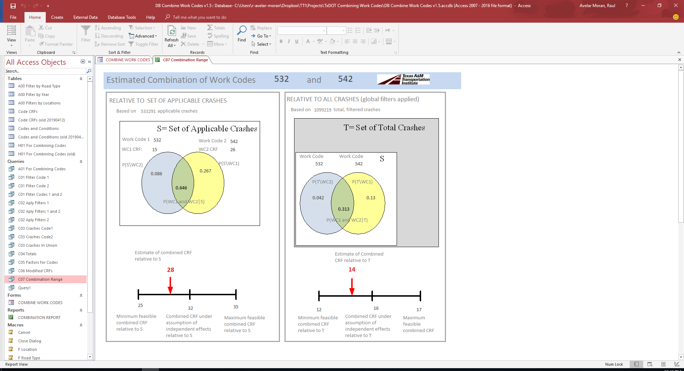
CRFs Relative to S or Total Crashes
S =applicable crashes either to WC1 or WC2
T = All crashes in facility of interest
Range and weighted average of combined CRFs are estimated relative to S and relative to T

Slide 21

Thank you
Srinivas Reddy Geedipally, Ph.D., P.E.
Associate Research Engineer
Texas A&M Transportation Institute
Srinivas-g@tti.tamu.edu
Tel 817.462.0519 ext 11519

